Slide 1
Theory of Automata (CSC- 402) Semester : Spring 2026 Credit Hours: 3

Slide 2
Theory of Automata Course
Lecture 7

Slide 3
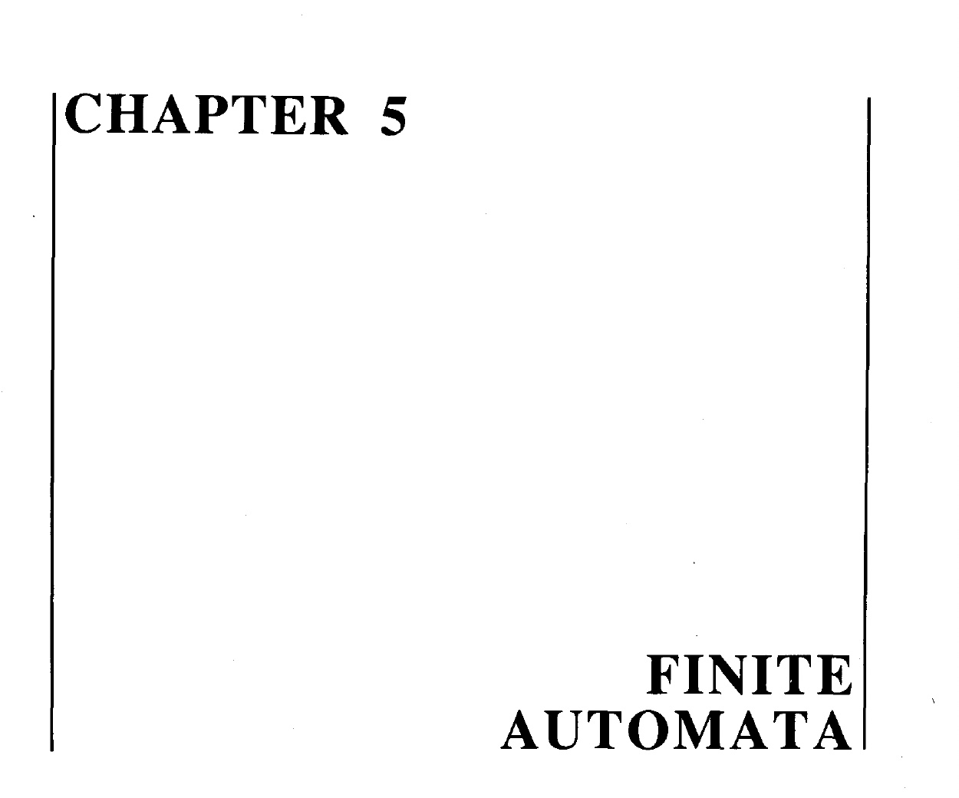

Slide 4
Note
It may be noted that to indicate the initial state, an arrow head can also be placed before that state and that the final state with double circle, as shown below. It is also to be noted that while expressing an FA by its transition diagram, the labels of states are not necessary.
a, b
a, b

Slide 5
Example
Σ = {a,b}
States: x, y, where x is both initial and final state.
Transitions:
At state x reading a or b go to state y.
At state y reading a or b go to state x.

Slide 6
Example Continued …
These transitions can be expressed by the following transition table
Old States | New States
 | Reading a | Reading b
x ± | y | y
y | x | x

Slide 7
Example Continued …
It may be noted that the previous transition table may be depicted by the following transition diagram.
a, b
x ±
y
a, b

Slide 8
Example Continued …
The previous transition diagram is an FA accepting the language of strings, defined over Σ={a, b} of even length. It may be noted that this language may be expressed by the regular expression
((a+ b) (a + b))*

Slide 9
TASK
Build an FA for the language L of strings, defined over Σ={a, b}, of odd length.

Slide 10
Solution of Task
a,b
–
+
a,b

Slide 11
Example: Consider the language L of strings, defined over Σ={a, b}, starting with b. The language L may be expressed by RE b(a + b)* , may be accepted by the following FA
a,b
––
b
+
a,b
a
1

Slide 12
Example:
Consider the language L of strings, defined over Σ={a, b}, ending in a. The language L may be expressed by RE
(a+b)*a
This language may be accepted by the following FA

Slide 13
Example Continued …
There may be another FA corresponding to the given language.
b
a
a
–
+
b

Slide 14
Example continued …
a
––
a
+
a
b
b
b

Slide 15
Note
It may be noted that corresponding to a given language there may be more than one FA accepting that language, but for a given FA there is a unique language accepted by that FA.

Slide 16
Note
It is to be noted that given the languages L₁ and L₂ ,where
L₁ = The language of strings, defined over Σ={a, b}, beginning with a
L₂ = The language of strings, defined over Σ={a, b}, not beginning with b
The Λ does not belong to L₁ while it does belong to L₂ . This fact may be depicted by the corresponding transition diagrams of L₁ and L₂.

Slide 17
FA₁ Corresponding to L₁
a,b
The language L₁ may be expressed by the regular expression a(a + b)*
––
a
+
b
a,b

Slide 18
FA₂ Corresponding to L₂
a,b
The language L₂ may be expressed by the regular expression a (a + b)* + Λ
±
a
+
a,b
b

Slide 19
Example
Consider the Language L of Strings of length two or more, defined over Σ = {a, b}, beginning with and ending in same letters.
The language L may be expressed by the following regular expression
a (a + b)* a + b (a + b)* b
It is to be noted that if the condition on the length of string is not imposed in the above language then the strings a and b will then belong to the language.
This language L may be accepted by the following FA

Slide 20
Example Continued …
b
a
a
+
a
b
–
a
b
b
b
+
a

Slide 21
Task
Build an FA accepting the Language L of Strings, defined over Σ = {a, b}, beginning with and ending in same letters.

Slide 22
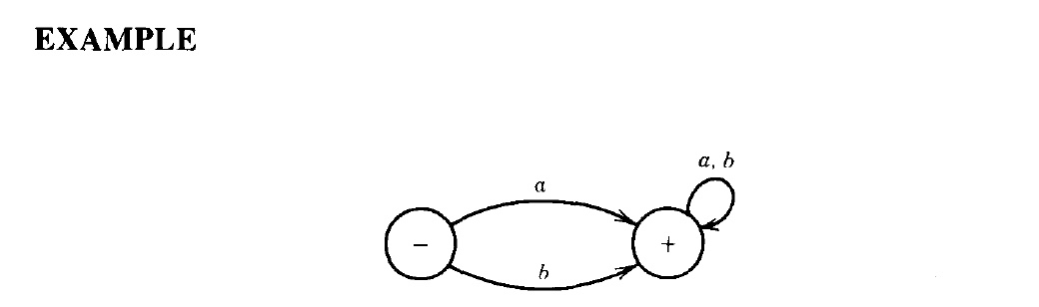
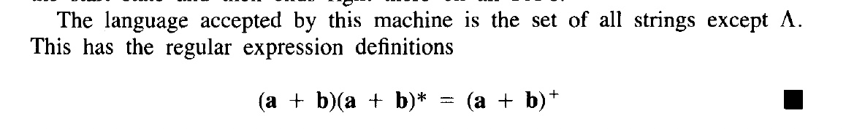

Slide 23
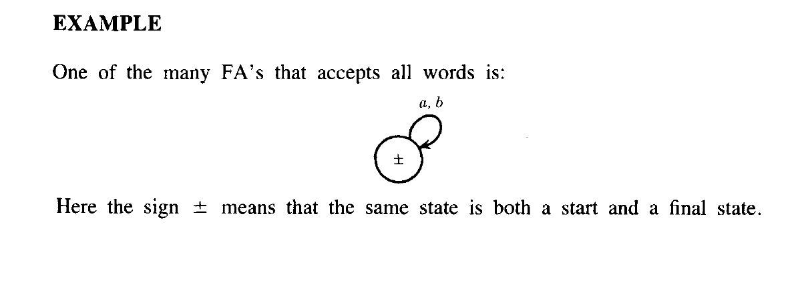
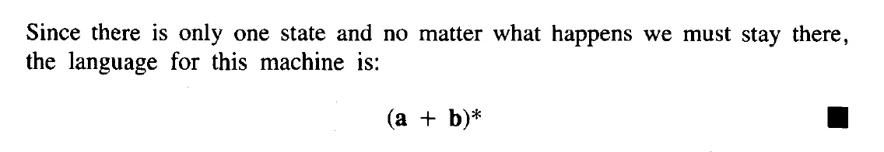

Slide 24
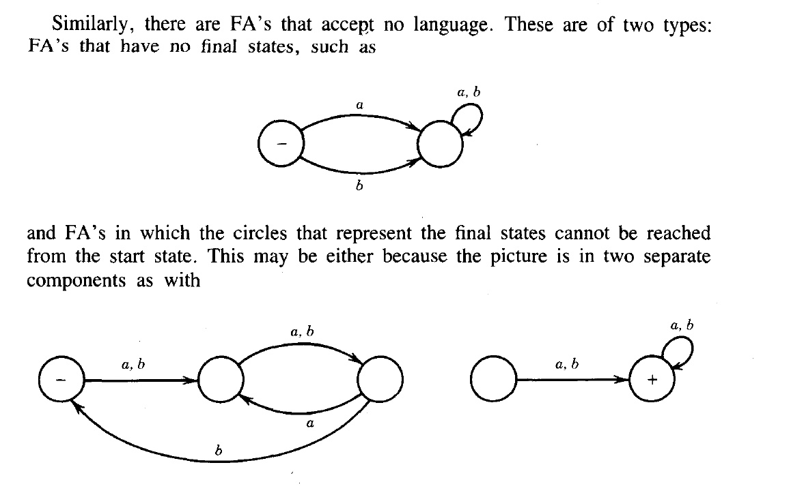
Disconnected Graph

Slide 25
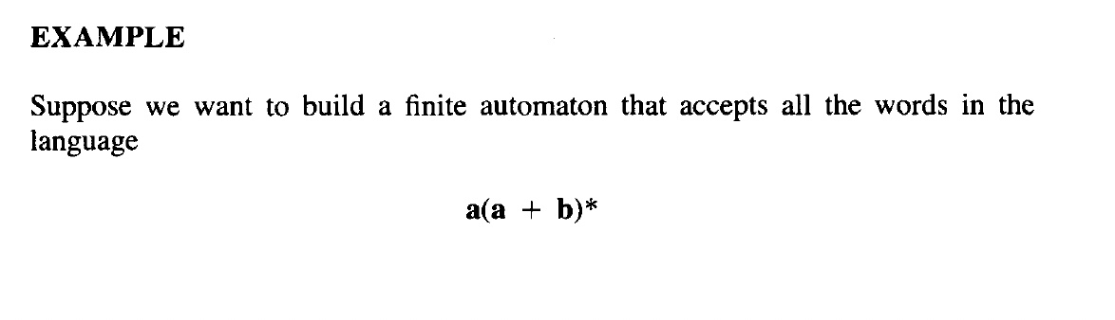

Slide 26
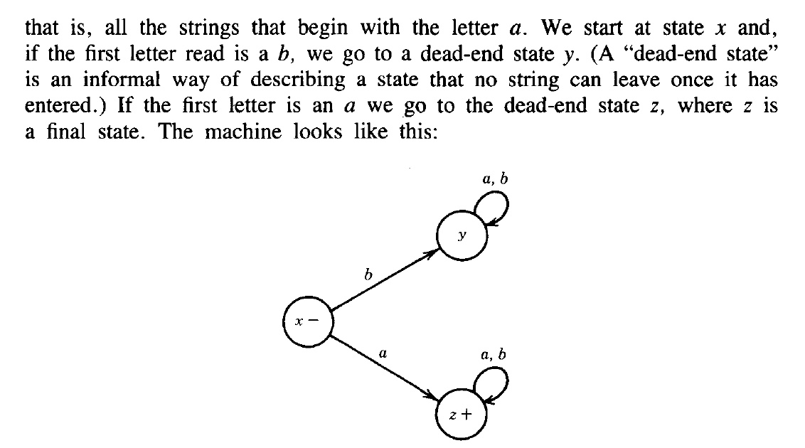
Solution 1

Slide 27
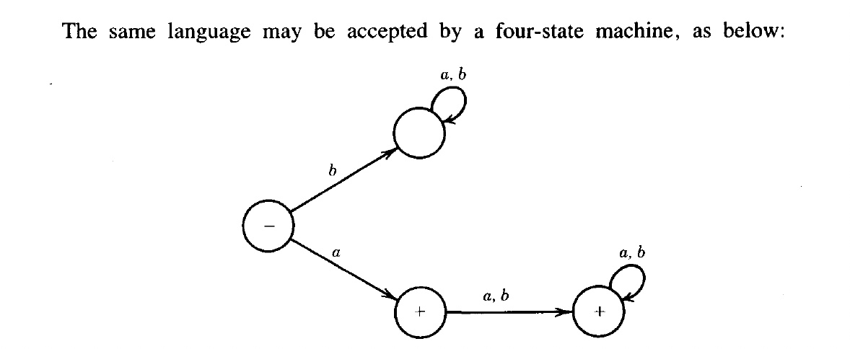
Second Solution

Slide 28
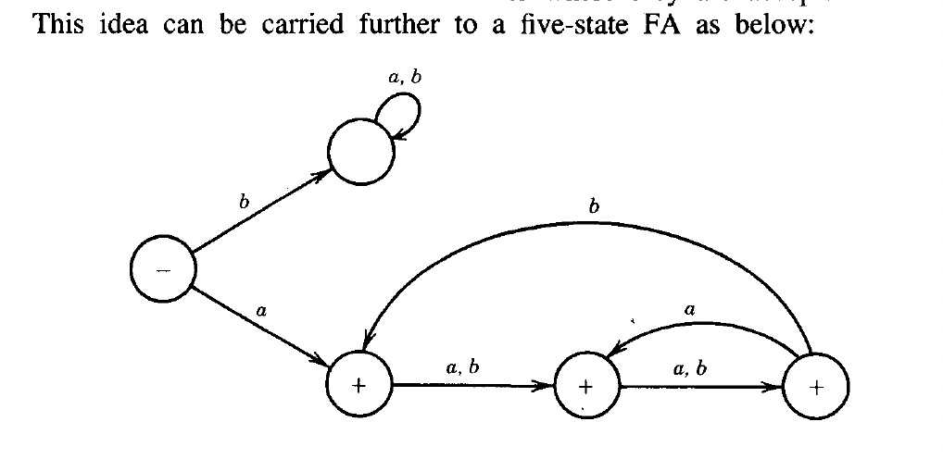
Third Solution

Slide 29
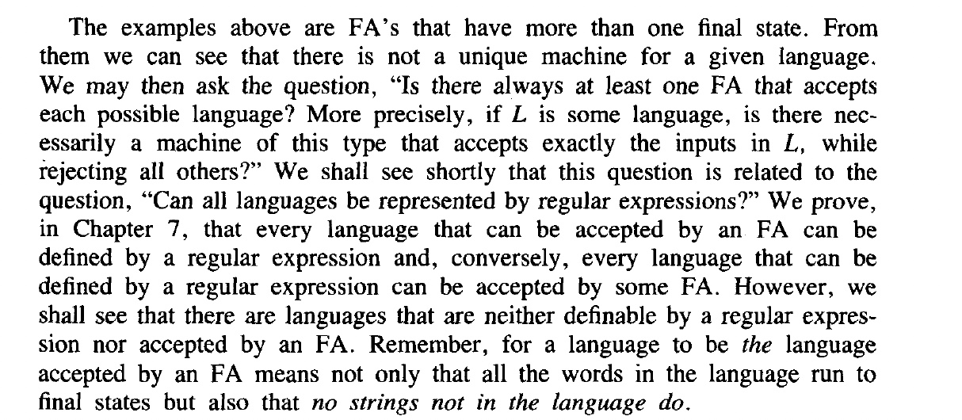

Slide 30
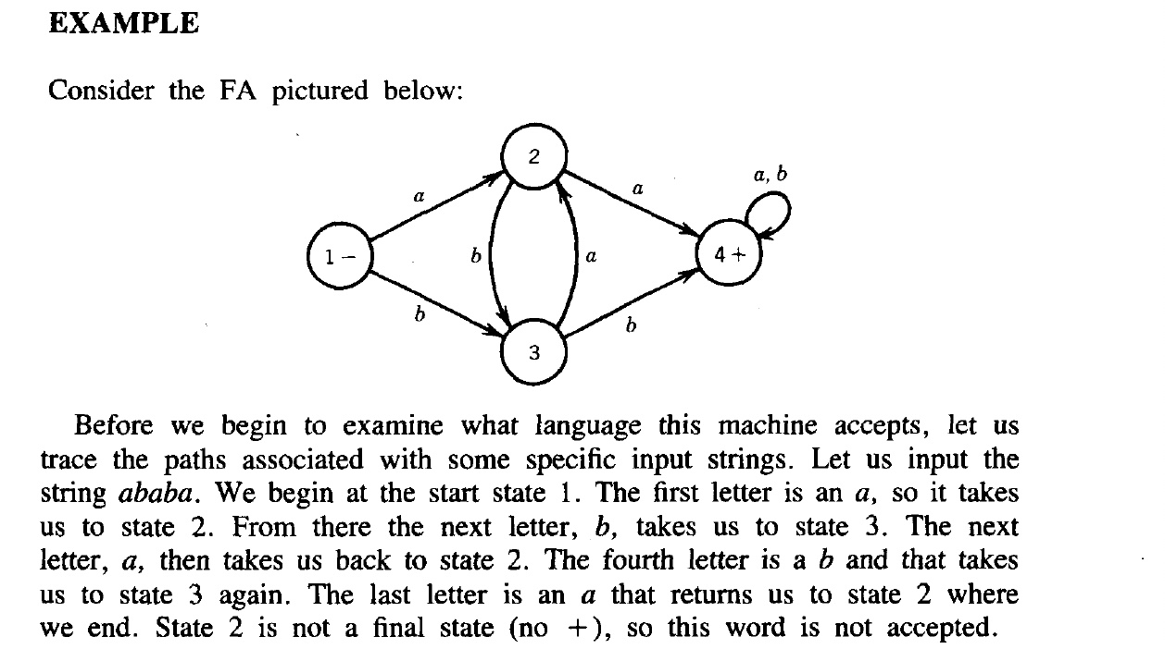
Example

Slide 31
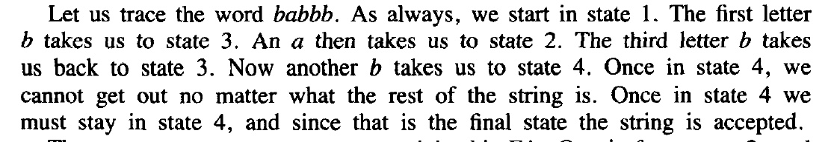
Same example - with different input string

Slide 32
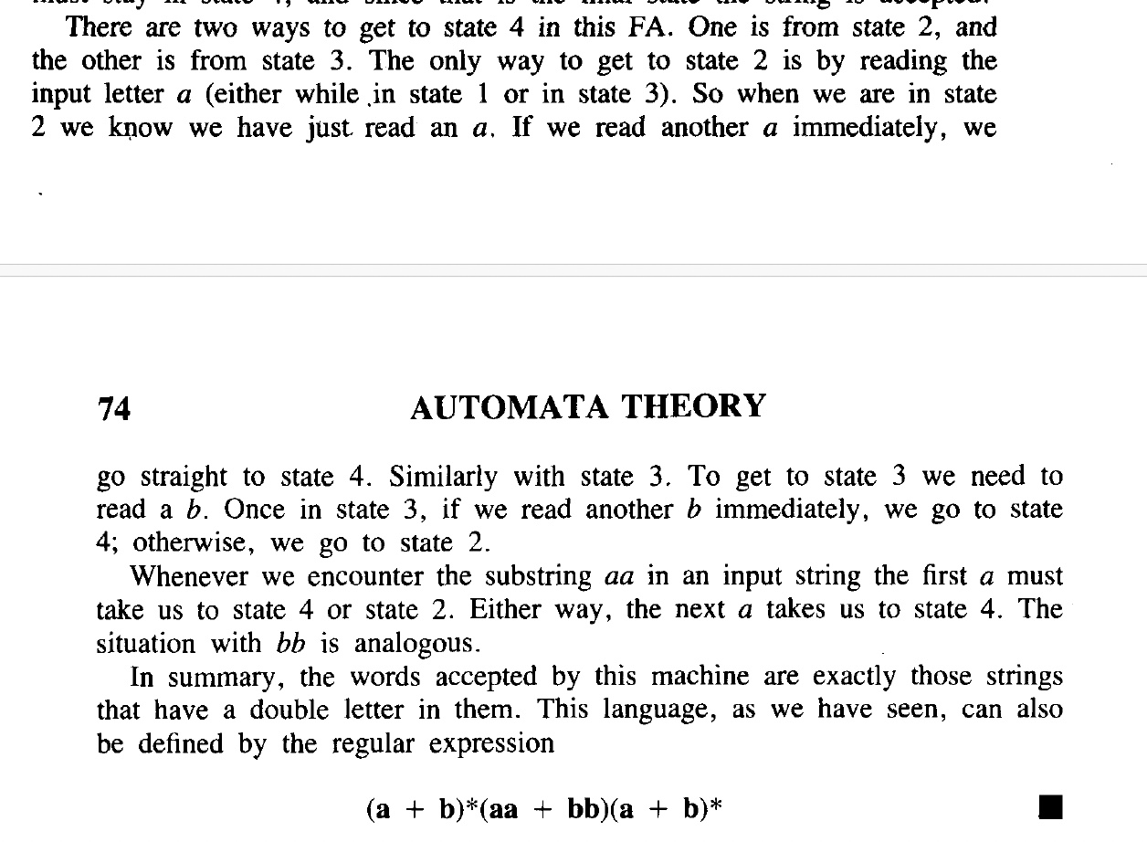
Explaination

Slide 33
End of Lecture

